Slide 1


Big Data & IPO Preparation

Slide 2


Today's agenda
Project recap
Problem
The Analytics team
Process
Insights
Summary

Slide 3

Social Buzz is a fast growing technology unicorn that need to adapt quickly to it’s global scale. Accenture has begun a 3 month POC focussing on these tasks:
Project Recap
An Audit of their big data practice
Recommendations for a successful IPO
Analysis to find Social Buzz’s top 5 most popular categories of content.

Slide 4

Problem
Over 100000 posts per day
36, 500, 000 piece of content per year
But how capitalize on it when there is so much?
Analysis to find Social Buzz’s top 5 most popular categories of content

Slide 5



1. Andrew Fleming
Role: Chief Technical Analyst
2. Marcus Rompton
Role: Senior Principle
3. Akshat Raj
Role: Data Analyst

Slide 6
Process
1
Data Understanding
2
Data Cleaning
3
Data Modelling
4
Data Analysis
5
Data Model

Slide 7

Insights
16
1897
MAY
UNIQUE CATEGORIES
REACTIONS TO “ANIMAL” POST
MONTH WITH MOST POSTS

Slide 8
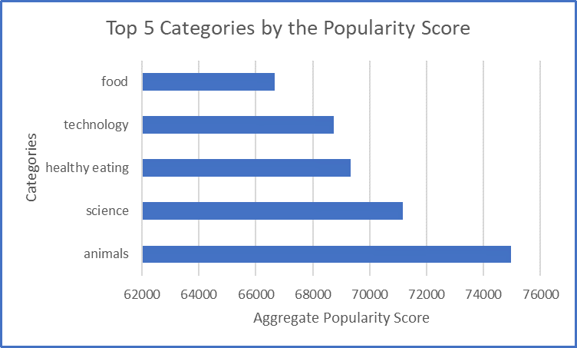

Slide 9
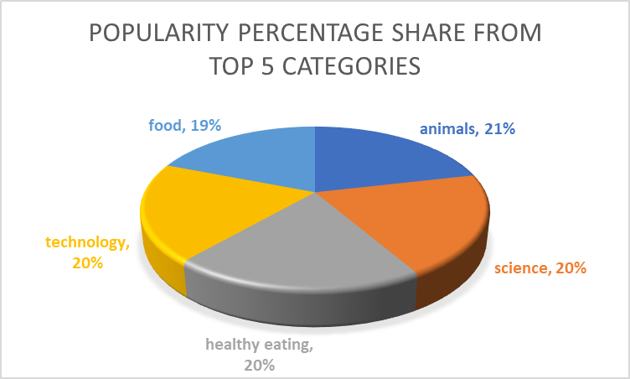

Slide 10
How many unique categories are there?
Studying, healthy eating, technology, food, cooking, dogs, soccer, public speaking, science, tennis, travel, fitness, education , veganism, animals, culture
There are 17 content categories

Slide 11
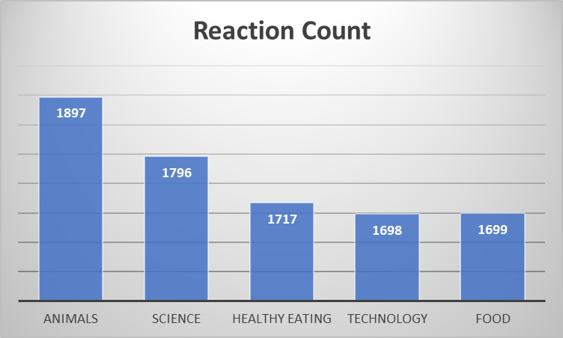
How many reactions are there to the most popular category?

Slide 12
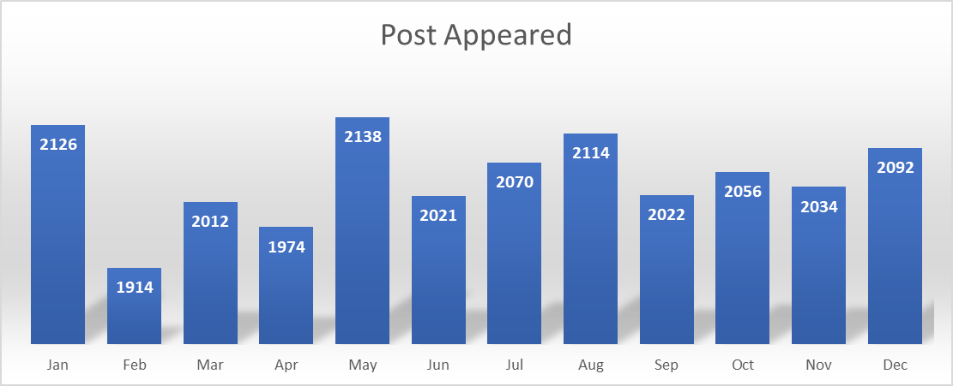
What was the month with the most posts
May with most post

Slide 13

In the initial phase of our engagement with Social Buzz, we gathered, selected, cleaned, and merged sample datasets to understand their data landscape better. Using SQL, we extracted representative datasets covering various content types. After thorough cleaning to ensure accuracy and consistency, we merged the datasets to provide a unified view of user interactions and content categories.
Summary

Slide 14
Thank you!
ANY QUESTIONS?

